Slide 1
Six Sigma Improvement Solution for Labeling Discrepancy of Environmental Monitoring and Critical Utility Samples
OIE-558: Designing & Managing Lean Six-Sigma Processes
Worcester Polytechnic Institute (WPI)
Final Project Presentation
24Apr2024
Team Delta
Celeste Souza, Dora Deab, Aarthi Mudiraj Garige, Joseph Martin, Aman Sahu

Slide 2
Problem Statement
The Quality Control Microbiology laboratory is frequently observing labeling discrepancies with environmental monitoring and critical utilities samples (two samples will have the sample label). This results in missing sample results (due to the requirement to invalidate the results), potential impact to product release, and wasted time/resources spent investigating the root cause. This can also result in a compliance risk as routine monitoring and testing of environmental monitoring and critical utility systems is required by procedures and regulatory requirements enforced by the Food and Drug Administration (FDA).

Slide 3
Proposal Statement
OBJECTIVE
Investigate why the Quality Control Microbiology laboratory is having labeling discrepancies with environmental monitoring and critical utilities samples.
RATIONALE
Reduce or eliminate the event from occurring, saving time and resources required for the investigations. The will support maintaining regulatory compliance and allow the continued manufacturing of medicines for patients
METHODS
Create a Process Flow Diagram/Value Stream Map
Perform a root cause analysis
Identify the root cause
Identify/implement corrective and preventive measures

Slide 4
Project Charter
Project Title | Six Sigma Improvement Solution for Labeling Discrepancy of Environmental Monitoring and Critical Utility Samples |  |  | Project Manager | Celeste Souza
Project Start Date | 01Feb2024 | Project End Date | 19Apr2024 | Project Sponsor | Quality Control
Problem Description | The Quality Control Microbiology laboratory is frequently observing labeling discrepancies with environmental monitoring and critical utilities samples (two samples will have the sample label). This results in missing sample results (due to the requirement to invalidate the results), potential impact to product release, and wasted time/resources spent investigating the root cause. This can also result in a compliance risk as routine monitoring and testing of environmental monitoring and critical utility systems is required by procedures and regulatory requirements enforced by the Food and Drug Administration (FDA). |  | Proposal Statement | Investigate why the Quality Control Microbiology laboratory is having labeling discrepancies with environmental monitoring and critical utilities samples.
Project Scope | Quality Control Microbiology laboratory labeling of environmental monitoring and critical utilities samples |  | Deliverables | Determine root cause for labeling discrepancies with environmental monitoring and critical utilities samples Identify CAPA actions for process improvement
Risks & Issues | Resources from support groups Timeline to complete actions |  | Assumptions/Dependencies | Dedicated time and resources from support groups CAPA actions will prevent future occurrences
Value Capture | Prevent future occurrences and improve the process by reducing deviations |  | Financials | Projected cost to complete this project is ~$6,000
Proposed Project Team |  |  | Milestones
Role | Team Member / % Time | Duration | Milestone | Finish | Functional Owner
Project Manager | Celeste Souza | Feb 2024 - April 2024 | Perform GEMBA | 16Feb2023 | Celeste Souza
Team Members | Dora Deab, Aarthi Mudiraj Garige, Joseph Martin, Aman Sahu | Feb 2024 - April 2024 | 2. Perform RCA | 23Feb2023 | Celeste Souza
 |  |  | 3. Identify CAPAs | 23Feb2023 | Celeste Souza

Slide 5
Environmental Monitoring
Environmental monitoring is used to observe the environment of a lab or manufacturing facility for its overall quality, environmental parameters, and the impact an activity may have, for example, water for injection (WFI), or EM settling plates.
There are 5 types of environmental monitoring:
Air/Atmospheric
For example, settling plates are used during this process by leaving a settling plate uncovered in a clean room to see if the room is truly free of particles in the air.
Soil
Testing out the soil to comprehend if there were any changes that can affect plant life or natural water resources.
Water
For example, WFI testing is needed for manufacturing facilities because the water used could be involved in possible drug products that are for humans.
Waste
This is based on the production and consumption of the company. The company needs to be mindful on what they produce to make sure that there are no bi-products that can harm the environment.
Noise
Manufacturing facilities machinery creates various loud noises, which can interfere with another group in another room who is working at a different step of the manufacturing process.

Slide 6
Critical Utility Monitoring
Critical Utility monitoring enables us to measure and track the usage of utilities in laboratory and manufacturing facilities. Tracking these utilities will help guarantee that drug products or drug substance are kept in the correct temperature for testing and storage.
Utilities used:
Ambient
Used to store samples in a room temperature range of 15-30C
Refrigerator
Used to store samples in a 2-8C range
Freezer
Used to store samples in different ranges:
-20C
-50C
-80C

Slide 7
Data Format & Levels of Support
Data Format
Direct Observation (GEMBA)
Interviews with Technicians
Review of SOP’s
Levels of Support
Management
Support is high as process improvements are required to avoid future deviations
Participation will vary based off competing priorities
Sampling Technicians
Support during interviews & GEMBAs was high
Support will be required for training and implementation on the new process

Slide 8
A3 Analysis
BACKGROUND
Pharmaceutical company in Massachusetts that is experiencing labeling issues with EM and CU samples resulting in missing sample results and deviations. A process improvement project was launched to reduce event occurrences and wasted time spent conducting investigations.
PROPOSED COUNTERMEASURES
Update SOP
Create a training plan
Update equipment
CURRENT CONDITIONS
Labeling issues are occurring due to a lack of clarification in the SOPs, difficulties with equipment, and a lack of training. Management would like to reduce event occurrences and wasted time spent conducting investigations.
IMPLEMENTATION PLAN
Having a SME look over the current SOP and update whether there is a discrepancy. Have a Senior Analyst creating a training plan to help pinpoint the areas that future associates needs a focus on. Also have a Validation group to check on equipment if they are functioning properly.
TARGETS/GOALS
Identify the Root Cause and CAPAs to reduce event occurrences and wasted time spent conducting investigations.
FOLLOW UP
Weekly team meetings to review project status.
Meet with management and quality control to review action items.
ANALYSIS
Due to the lack of training, SOP clarification, and the age of equipment associates are having a hard time labeling samples. This causes a delay in testing and certain assays are on a strict turnaround time.

Slide 9
SIPOC
Suppliers
Environmental Monitoring Technicians
Inputs
Sampling Technicians
MODA System
Portable Zebra Printers
Sample Containers
SOP’s
Process
Print labels from MODA using Zebra printers
Adhere Sample Labels to containers
Collect Samples
Adhere Sample Labels to containers (if not done before collection)
Output
Testing results entered into MODA
Manufacturing rooms and systems within environmental monitoring and critical utility limits
Customer
Internal
Trend Reports
External
Food and Drug Administration (FDA)
Patients

Slide 10
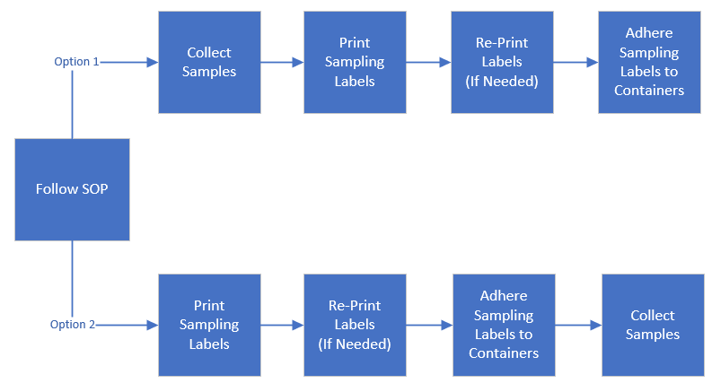
Current Process Flow Diagram / Value Stream Map

Slide 11
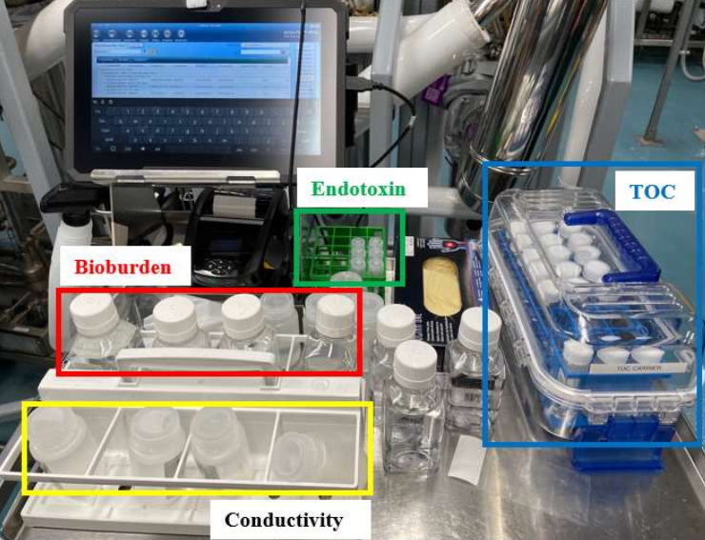
Current Process Flow Diagram / Value Stream Map
Four Sample Types
TOC
Conductivity
Bioburden
Endotoxin

Slide 12
Time Value of Money (TVM) Analysis - Net Present Value (NPV)
For this analysis, the average hourly pay for the Environmental Monitoring Technician in Boston will be $18.21 an hour, and the average hourly pay of the Quality Control Investigator will be $21.76 an hour. We will also estimate that implementing measures to reduce the labeling discrepancies can save 10 hours per month for the Environmental Monitors and will save 5 hours per month for the Quality Control Investigators. We will also assume the discount rate is 5%.
1. Calculating the Cost Savings:
Environmental Monitoring Technician: 10 hours/month x $18.21/hour = $182.10/month
Quality Control Investigator: 5 hours/month x $21.76/hour = $108.80/month
Total Monthly Savings = $182.10 + $108.80 = $290.90
Total Annual Savings = $290.90 x 12 = $3,490.80
2. Time Value of Money Analysis:
PV = (Future Value)/(1+r)^n
PV = ($3,490.80)/(1+0.05)^1 = $3,324.57

Slide 13
Cost Analysis
Improving how we label environmental monitoring and critical utility samples is important because it helps us get accurate data and saves money. Let's look at some ways to improve labeling and how they relate to saving costs:
1. Better Labeling Rules: When everyone follows the same labeling rules, it keeps things organized and saves time. Yes, it costs a bit to train everyone and make new rules, but in the long run, it saves money because we make fewer mistakes and don't have to redo things.
2. Using Barcodes: Ever seen those funny lines on products in the store? Those are barcodes! They help us scan and track things quickly. Buying barcode scanners and software might seem expensive, but they help us avoid mistakes and work faster, saving money in the end.
3. Checking Quality: Checking labels might seem like extra work, but catching mistakes early on saves a lot of trouble later. It costs a bit to do these checks, but it's worth it because we don't waste time fixing mistakes or risk getting in trouble for wrong data.
4. Electronic Systems: Switching to electronic systems means less paper and more organization. Sure, it costs money to set up, but it saves time and money in the long run because we can find things faster and don't have to deal with messy paperwork.
5. Audits and Inspections: Audits and inspections are like check-ups for our labeling process. They cost a bit because people need to spend time checking things, but they help us catch mistakes early and avoid big problems later, which saves money.
6. Training and Education: Teaching people the right way to label things might seem like a hassle, but it pays off. Spending money on training helps us avoid mistakes and work more efficiently, saving time and money down the line.
So, By integrating cost analysis into the evaluation of improvement solutions for labeling discrepancies in environmental monitoring and critical utility samples, organizations can make informed decisions that balance the upfront investment with the long-term benefits in terms of cost savings, efficiency gains, and improved data quality.

Slide 14
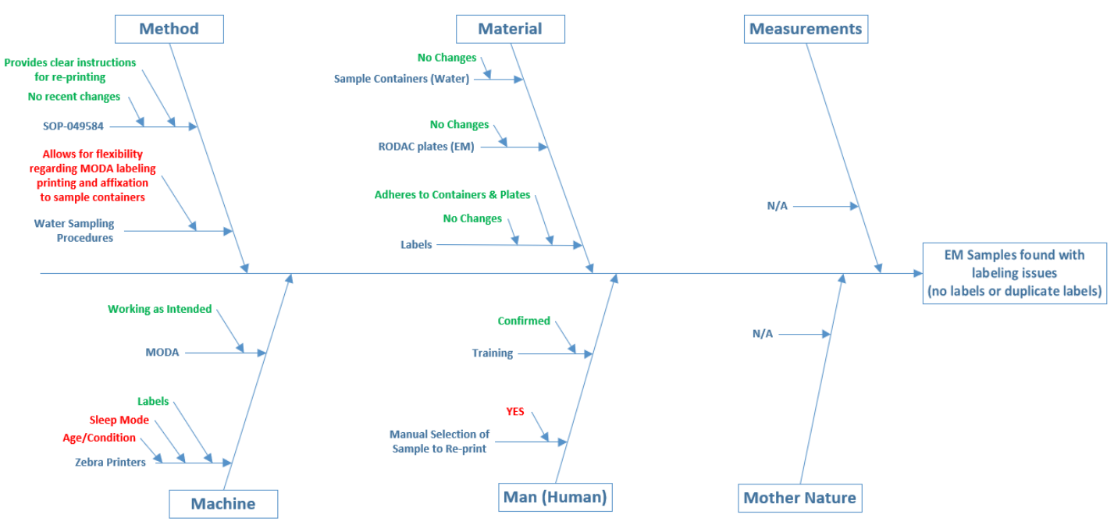
Root Cause Analysis - 6M Fishbone Diagram

Slide 15
Root Cause Analysis - 6M Fishbone Diagram
Event | Title | RCA Category | Category
1 | Environmental monitoring samples unable to be tested due to duplicate labels | PROCESS • Analyst selected the incorrect samples when re-printing. | Method – Inadequate sampling process/method
2 | Water collection sample containers found with duplicate labels prior to TOC testing | PROCESS • Printer malfunction that forced the analyst to perform a re-printing activity, wherein the error occurred when there were excess TOC labels printed. | Machine – Hardware/software malfunction
3 | Routine water conductivity sample found unlabeled prior to testing | TRAINING • Analyst selected the incorrect samples when re-printing | Method – Training was inadequate/ ineffective
4 | Water collection sample containers found with duplicate labels & no labels prior to Endotoxin, Conductivity, TOC testing | PROCESS • Analyst selected the incorrect samples when re-printing | Method – Inadequate sampling process/method
5 | Environmental Monitoring samples mislabeled and unable to be plate read due to labeling issue | TRAINING • Analyst selected the incorrect samples when re-printing | Method – Training was inadequate/ineffective

Slide 16
Root Cause Analysis - Summary
Based off the information gathered from the individual events in scope, interviews and GEMBA, the 6M Fishbone Diagram it was determined that:
Certain Zebra printers are older versions that enter the idle “sleep mode” faster than others (which causes the need for re-printing).
The USB port connection and adapter cords are not always functioning as intended and require the use of the USB-C port and adapter cord (the only have one connection for 2 pieces of equipment)
The procedures for sampling water at the various manufacturing facilities allow for MODA labels to be printed and affixed to the collection container either prior to or immediately following the collection of the sample. The procedure does not provide clear instructions to ensure the sample label on the container is verified to contain the correct sample site, MODA# and date.
The process of printing labels, adhering labels, and collecting EM and CU Water samples is a manual process. When re-printing sample labels, if sample sites are collected at a higher frequency than weekly the search would result in multiple samples from the same site differentiated by date and MODA sample identification number. This could potentially lead to an increased likelihood the incorrect sample date/MODA number is selected by the EM Technician. In addition, adhering sample labels to the bottle is a manual process that requires the human to physically check that the process has been completed correctly

Slide 17
Corrective & Preventive Actions (CAPA)
Replacement of older models of the Zebra printers used for printing EM & CU Water sample labels
Evaluation of the Zebra printers to increase the time before entering the idle “sleep mode” and ensure all units are set to consistent times
Evaluate the possibility of getting a USB-C adapter cord that has a splitter to two USB connection sites
Revise the water sampling procedures to remove the ability to label water collection containers after sampling. The instructions will be defined to state: print label, adhere label to container, collect sample, verify sample label information is accurate for the correct sample site, MODA# and date.
Revise training guide to remove the ability to label water collection containers after sampling. The instructions will be defined to state: print label, adhere label to container, collect sample

Slide 18
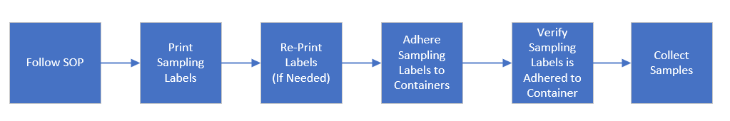
New Process Flow Diagram / Value Stream Map
The SOP no longer allows analysts an option for when the sampling labels can be printed. The MODA labels will need to be printed and affixed to the collection container prior to the collection of the sample. The procedure also has instructions to ensure the sample label on the container is verified to contain the correct sample site, MODA# and date.

Slide 19
Results & Conclusions
Countermeasures Implemented:
Replacement of older Zebra printers to eliminate malfunctions causing re-printing.
Evaluation of printer settings to extend the idle "sleep mode" time uniformly.
Assessment of USB-C adapter cords to ensure reliable connections.
Revision of water sampling procedures to prevent labeling after sampling, ensuring accuracy.
Enhancement of training materials to reinforce proper labeling procedures.
Production Metrics:
Reduction in labeling discrepancies leading to missing sample results.
Decreased time and resources spent on investigations and invalidation of results.
Improvement in compliance with regulatory requirements, reducing compliance risks.
Investment in Training and Equipment:
Allocation of resources for printer replacements and evaluation.
Investment in training programs to educate staff on revised procedures.
Enhanced focus on equipment maintenance and usability to prevent future discrepancies.

Slide 20
Projected Savings
Labeling discrepancies in the Quality Control Microbiology laboratory have emerged as a critical issue, jeopardizing regulatory compliance, product quality, and operational efficiency. These discrepancies manifest in duplicated sample labels, leading to errors in sample identification and subsequent invalidation of results. Such occurrences not only necessitate resource-intensive investigations but also pose compliance risks due to non-adherence to regulatory requirements enforced by the Food and Drug Administration (FDA). Consequently, this study aims to investigate the root causes of labeling discrepancies and propose corrective and preventive measures to mitigate their occurrence.
Methods: A systematic methodology is employed to investigate labeling discrepancies in the Quality Control Microbiology laboratory. Initially, a process flow diagram/value stream map is constructed to visualize and analyze the sample handling process, identifying potential areas of error and inefficiency. Subsequently, a root cause analysis is conducted to delve into the underlying factors contributing to labeling discrepancies, utilizing techniques such as the fishbone diagram or the 5 Whys approach. Based on the findings of the root cause analysis, corrective and preventive measures are identified and implemented to address the identified issues and improve labeling accuracy and consistency.
Projected Savings Assessment:
The projected savings resulting from the implementation of corrective and preventive measures to mitigate labeling discrepancies are assessed across various dimensions:
1. Reduction in Investigation Time and Resources: By addressing the root causes of labeling discrepancies, the need for resource-intensive investigations is minimized, leading to significant time and cost savings associated with personnel allocation and investigative efforts.
2. Minimization of Sample Result Invalidations: Enhanced labeling accuracy and consistency contribute to a reduction in the number of sample result invalidations, mitigating the need for retesting and additional sampling and resulting in savings in laboratory resources and operational costs.
3. Prevention of Compliance Risks and Regulatory Penalties: The implementation of measures to improve labeling practices reduces the risk of non-compliance with regulatory requirements enforced by the FDA, thereby averting potential regulatory penalties, fines, or operational suspensions.
4. Enhancement of Operational Efficiency: Standardizing labeling procedures, introducing barcode systems, and enhancing training programs improve operational efficiency in the laboratory, resulting in savings through increased productivity, reduced rework, and optimized resource utilization.
The investigation and mitigation of labeling discrepancies in the Quality Control Microbiology laboratory are essential for ensuring regulatory compliance, maintaining product quality, and optimizing operational efficiency. By systematically identifying and addressing the root causes of these discrepancies and implementing corrective and preventive measures, significant savings can be projected across various dimensions, contributing to the overall effectiveness and sustainability of laboratory operations.

Slide 21
Value to Company
Operational Efficiency: Implementation of corrective actions enhances operational efficiency by reducing labeling discrepancies, minimizing sample rejections, and optimizing resource utilization.
Compliance Assurance: Mitigating labeling errors ensures adherence to regulatory requirements, reducing compliance risks, and potential regulatory sanctions.
Cost Savings: Eliminating wasted resources on investigations and retesting, along with preventing product release delays, results in significant cost savings over time.
Enhanced Reputation: Ensuring accurate sample labeling and reliable testing procedures enhances the company's reputation for quality and reliability within the industry and among regulatory bodies.
Strategic Advantage: Improved environmental monitoring and critical utility systems bolster the company's competitive position, potentially attracting more clients and enhancing market share.
Long-term Sustainability: By investing in process improvements and training, the company demonstrates its commitment to continuous improvement and long-term sustainability, fostering stakeholder trust and confidence.

Slide 22
Key Learnings
Root Cause Analysis (RCA) identifies underlying issues.
Countermeasures like SOP updates and training improve processes.
Cross-functional collaboration enhances problem-solving.
Continuous improvement culture sustains enhancements.
Compliance measures mitigate regulatory risks.
Data-driven decisions optimize operations.
Training and equipment investments reduce errors.
Standardized procedures promote consistency.
Continuous monitoring ensures ongoing improvement.
Focus on customer impact ensures product quality.

